Slide 1

Notes:
This is Polly – the resiliency framework for .NET
Assume some basic knowledge of Polly (have another workshop for working with Polly, but assuming basic knowledge of what a retry is etc. How to use it
in any detail is not required, but a basic conceptual understanding of Polly helps)

Slide 2
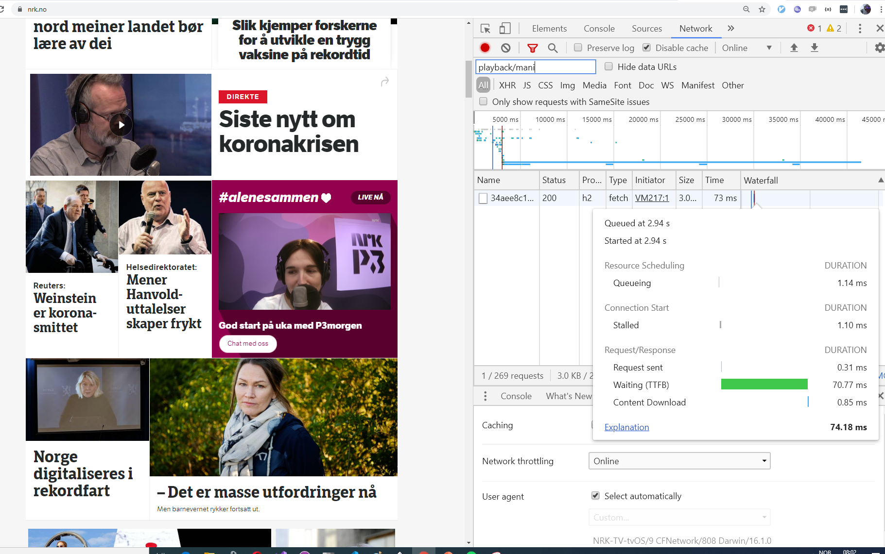

Notes:
Why are we here?
These videos rely on an API calling among other things to play, the request has a 99 percentile of approx 30 ms, running on .NET Core 3.1 on Alpine Images on a geo-redundant app service.
It mostly works very well.

Slide 3
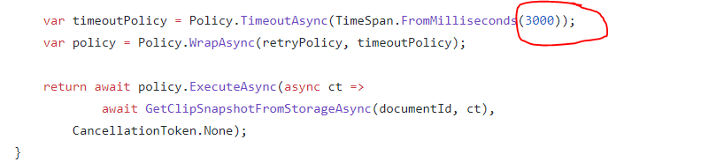
Notes:
This timeout is what this is about. Not nescesarily all the other code. How does this influence our system?
This is not an answer, but a workshop to give some intuition and a playground to play with these to see how they work .
How is the system reliability and performance affected by this? Realistic tests are required – prefferably production data – but to learn a faster feedback loop would be nice, no?
Ask questions in the chat. Who has used Polly? Who has used similar frameworks? Who hasnt used it but understand the basics… Who are mostly confused at this point?

Slide 4
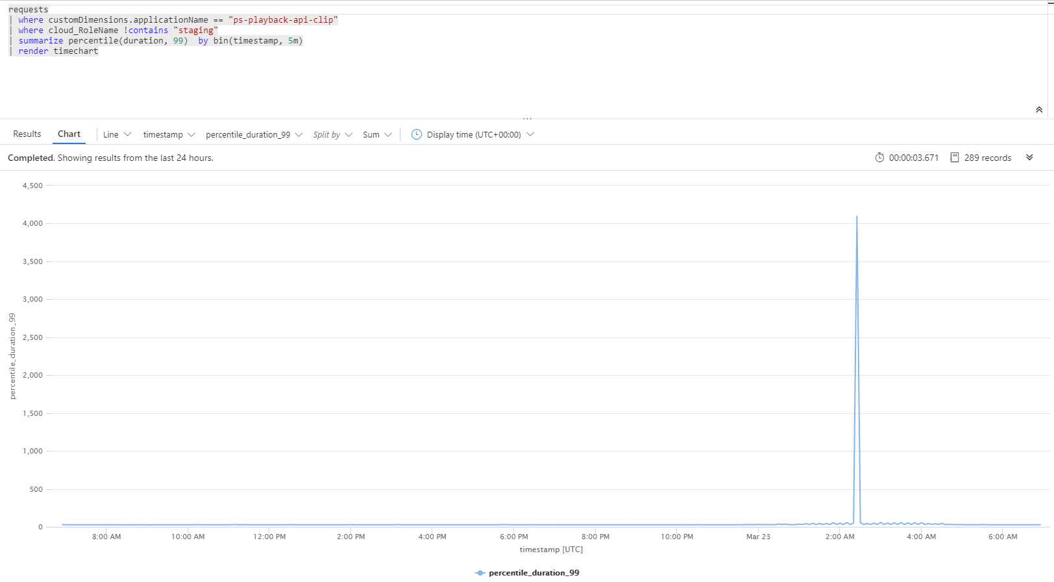
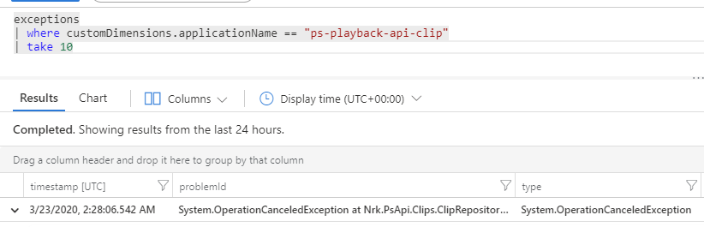
Notes:
The 99 percentile is more or less the timeout value. This is the real world, so other things happen, other timeouts happen too…
But when Cosmos faeiled at some time during the night and started timing out we dont wait for the default timeout.
This looks bad. 4 seconds is a long time. But 30 seconds is worse. What is the correct time to wait?
We need the lab. We see a spike in 500, but we have more than
3 million 200
- 400 and 404
- 47 500 or 503

Slide 5
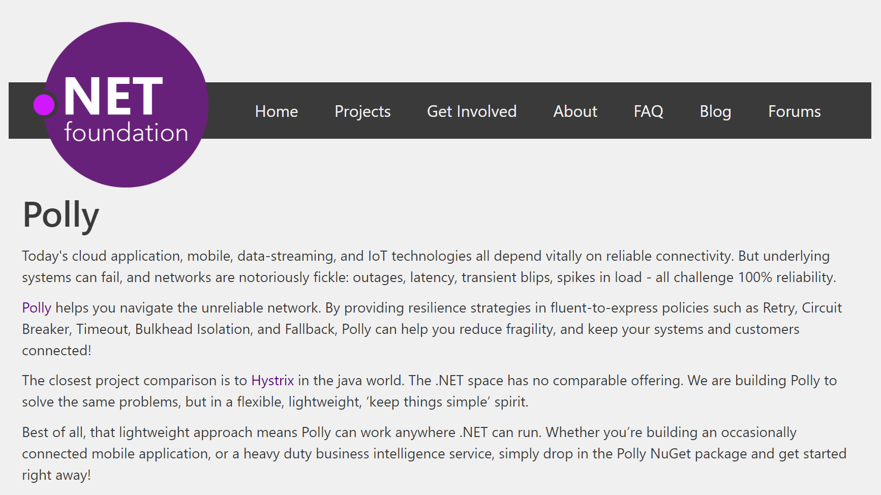
Notes:
Polly was accepted into the .NET Foundation in October, 2016!!
https://github.com/App-vNext/Polly
Polly lets us configure this and we can see it in production.

Slide 6
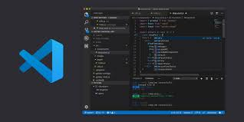


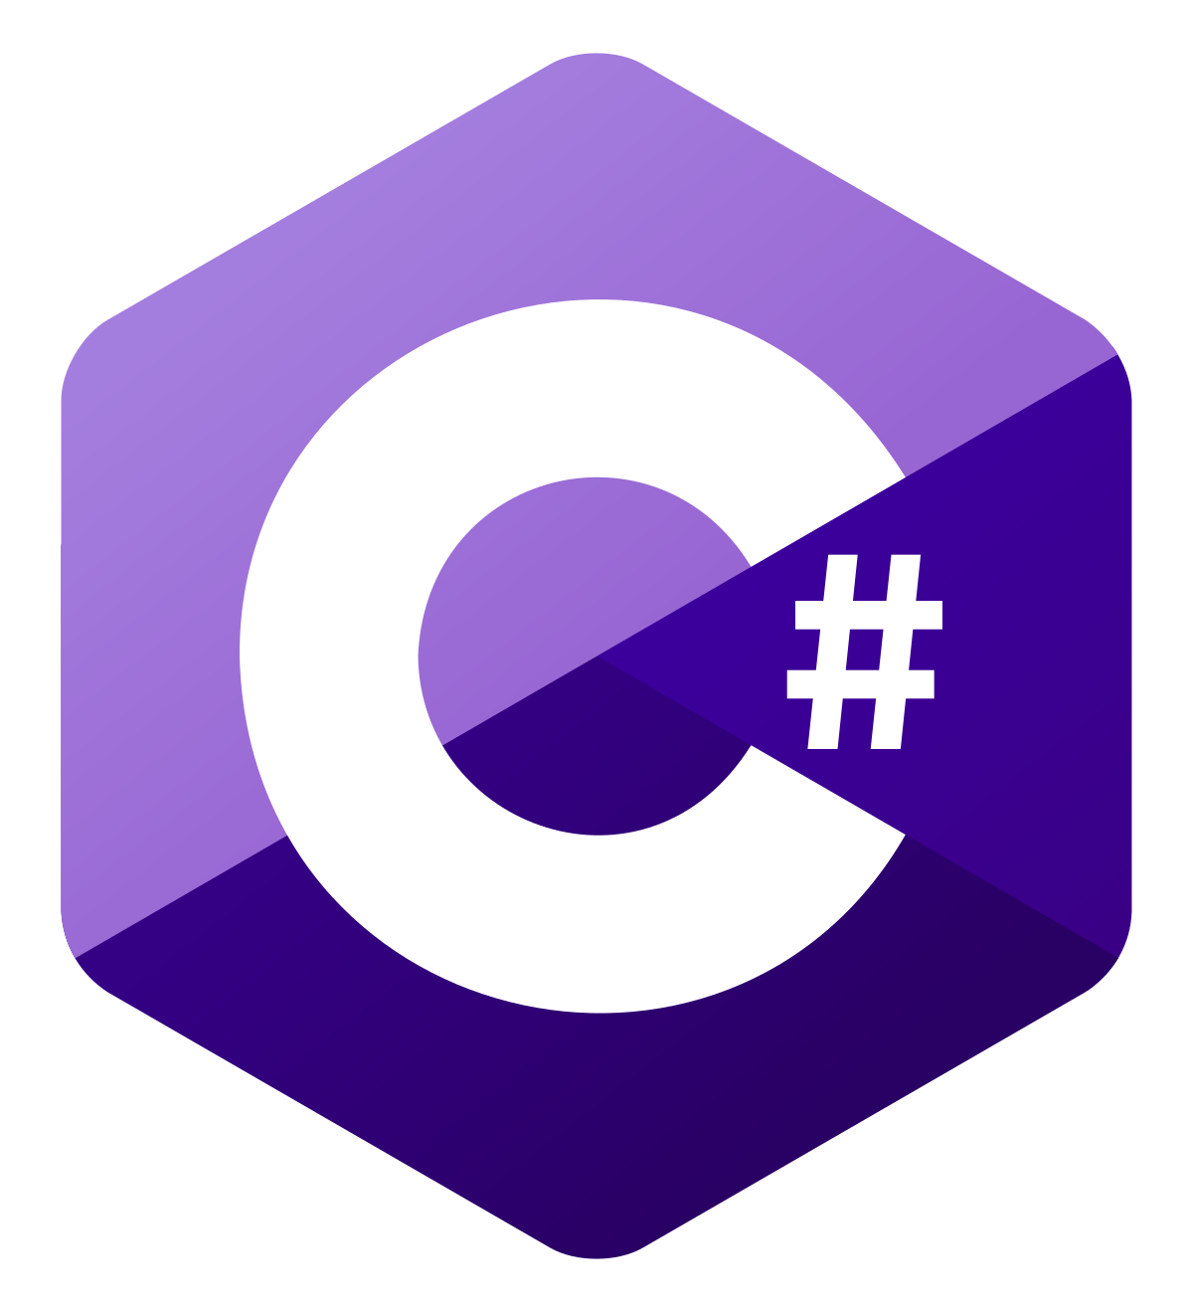


Notes:
Lots of moving parts and frameworks. Dont worry. It is all configured and most of the stuff is just changing a parameter or two.
Should work on all plattforms, but a little trickier on Ubuntu because of certificates.

Slide 7
Browser
K6 Load Tests
(Optional)
(running in Docker)
Load-tests
Nbomber
Xunit
(Program.fs)
API under test (Weather forcecast API)
https://localhost:5001/weatherforecast_intro
https://localhost:5001/weatherforecast_challenge0
Notes:
Starter først APIet.
Ser litt på det….
Deretter testene.
Lar k6 ligge
We can start the API and look at some routes first.

Slide 8
Challenge 0
Just to get started
Watch the API.
Test in browser
Run the tests…
Notes:
Answer in the chat.

Slide 9
Poo

Slide 11

P(FEIL) = 0.1
En retry – 1- P(FEIL)*P(FEIL)
N retry – 1- P(FEIL) OPPHØYD I N
Notes:
Stochastic
But what distribution does it follow. It is not uniform. You might have a minute of only failures and then everything is ok again. So remember with retries, even if Simmy assumes things are randomly distriubted
variables, they dont have to random and therefore things do break down a bit…. If a database fails for 5 minutes and has 100% uptime the reset of the day, 10 second retries will do very little to help.
https://en.wikipedia.org/wiki/Probability_distribution

Slide 12
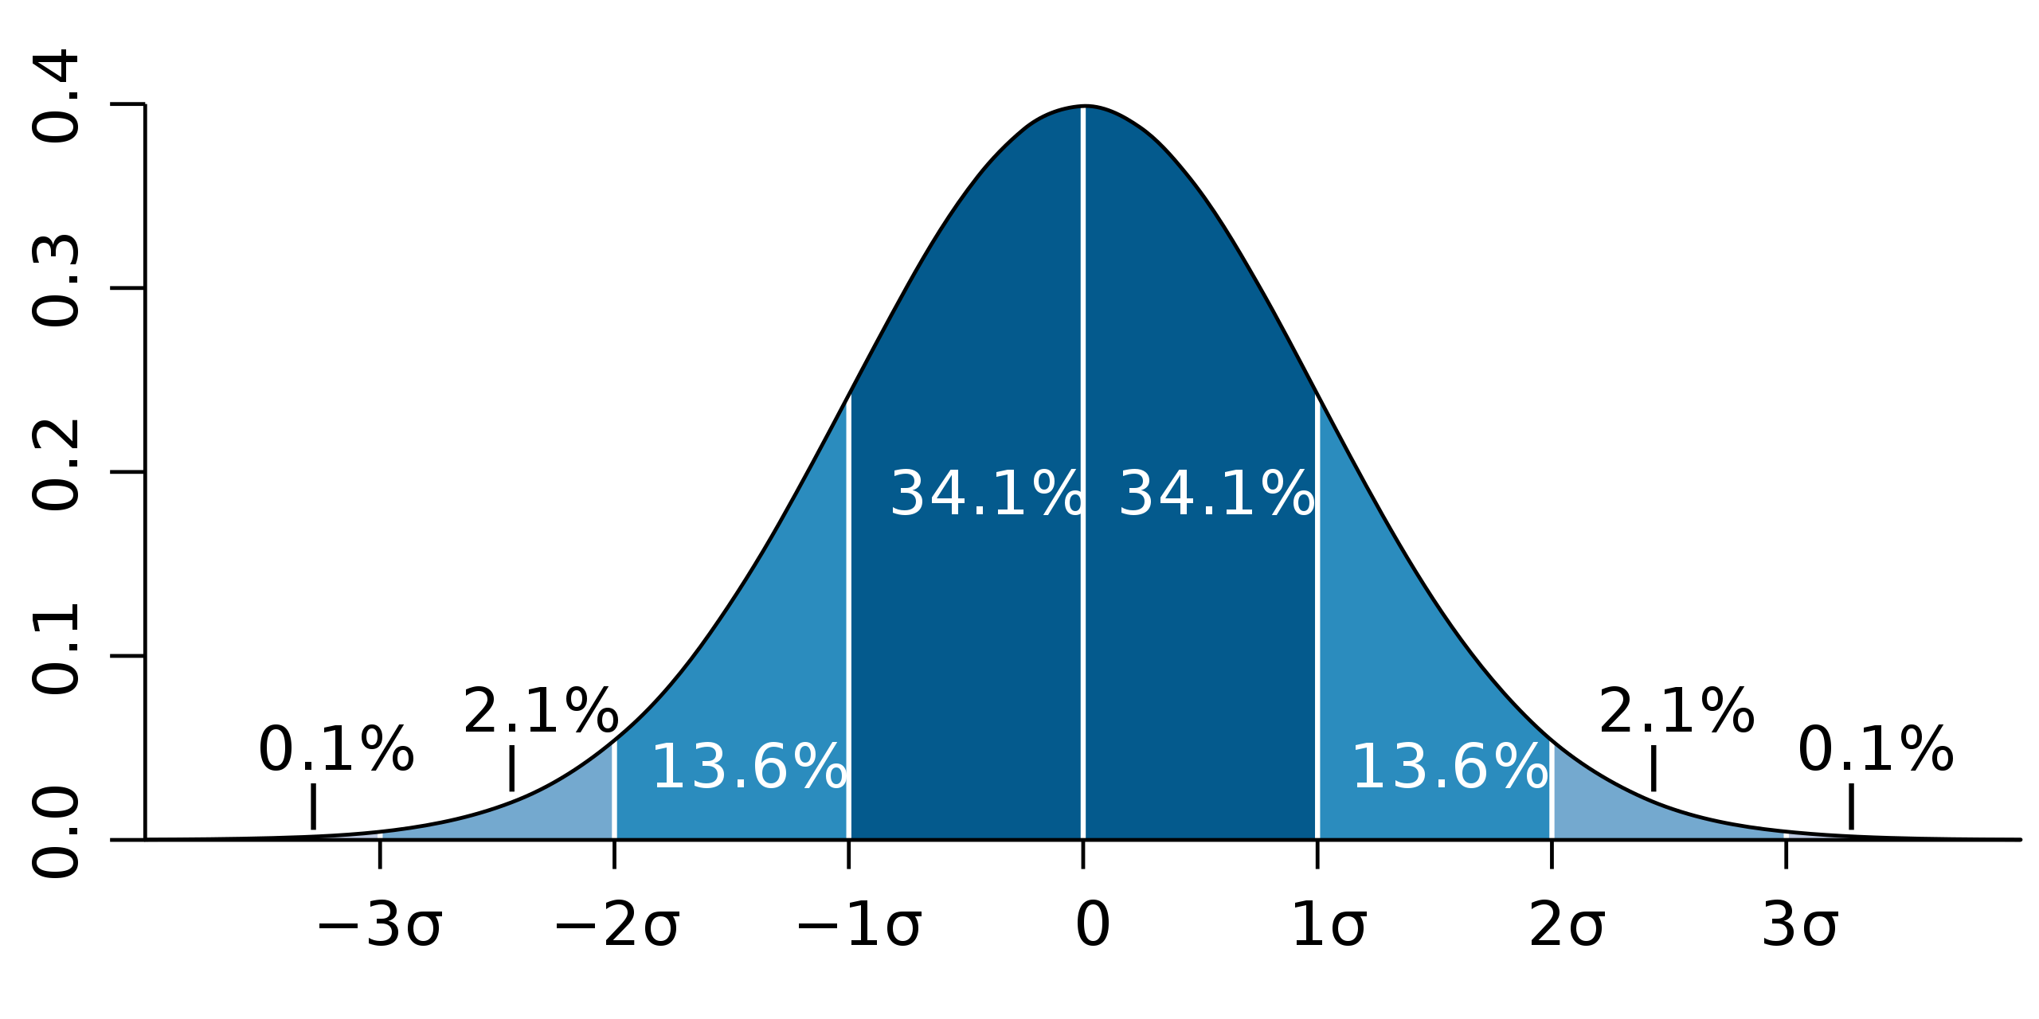
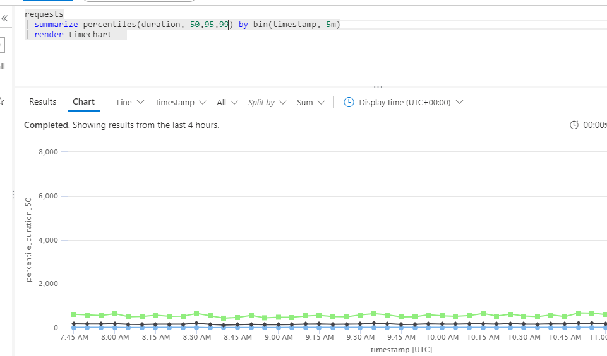
Notes:
50,95, 99 percentiles
Igjen, mye av dette er ikke normalfordelt. Så litt forsiktig må vi alltid være.
95% er ca to standard avvik ved normalfordeling. 3 er 99.7, vi ser ofte på 95 og 99.

Slide 13
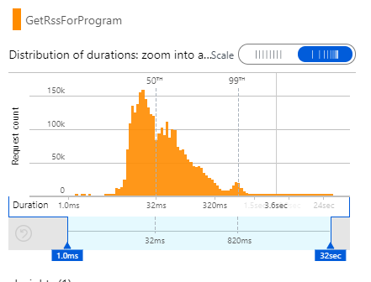
Notes:
Vi er ikke alltid normalfordelte.

